Slide 1
EMOTION BASED MUSIC PLAYER

Slide 2
PROPOSED SYSTEM:
Extremely fast features computation.
Efficient features selection.
Scale and location invariant detector.
Instead of scaling the image itself, we scale the features.
Such a generic detection scheme can be trained for detection of other types of objects.
High accuracy.
Existing System:
Detector is most effective only on frontal images of faces.
Sensitive to lighting conditions.
We might get multiple detections the same face, due to overlapping sub-windows.
Low accuracy.

Slide 3
ARCHITECTURE
Find Accuracy
Algorithm Selection
DataSets
Data cleaning
Feed into Algorithms
Using algorithm
Combine DataSets
Data Pre-processing
Data transformation
Convert into Array values
Result
Data selection

Slide 4
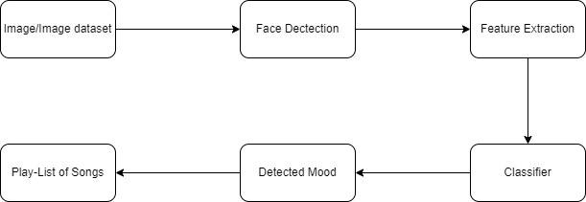

Slide 5
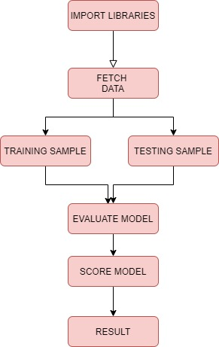
ACTIVITY DIAGRAM

Slide 6
LITERATURE SURVEY
S.NO | TITLE | CONTENT | AUTHOR | YEAR
1 | An Intelligent Music Player Based on Emotion Recognition | This paper proposes an intelligent agent that sorts a music collection based on the emotions conveyed by each song and then suggests an appropriate playlist to the user based on his/her current mood. The user's local music collection is initially clustered based on the emotion the song conveys, i.e. the mood of the song. This is calculated taking into consideration the lyrics of the song, as well as the melody. Every time the user wishes to generate a mood-based playlist, the user takes a picture of themselves at that instant. This image is subjected to facial detection and emotion recognition techniques, recognizing the emotion of the user. The music that best matches this emotion is then recommended to the user as a playlist. | Radha Kumaran; R Ram Rohan; Rajat Gupta; Vishalakshi Prabhu | 2018

Slide 7
LITERATURE SURVEY
S.NO | TITLE | CONTENT | AUTHOR | YEAR
2 | Emotion-Based Music | Nowadays, people tend to increasingly have more stress because of the bad economy, high living expenses, etc. Listening to music is a key activity that assists to reduce stress. However, it may be unhelpful if the music does not suit the current emotion of the listener. Moreover, there is no music player which is able to select songs based on the user emotion. To solve this problem, this paper proposes an emotion-based music player, which is able to suggest songs based on the user's emotions; sad, happy, neutral and angry. | Raphatsak Sriwatanaworachai; Supannada Chotipant | 2019

Slide 8
LITERATURE SURVEY
S.NO | TITLE | CONTENT | AUTHOR | YEAR
3 | A Machine Learning Based Music Player by Detecting Emotions | The paper constitutes the implementation of Convolutional neural network for the emotion detection and thereby playing a song accordingly. Segregating the songs and playing them in accordance to one's mood could facilitate the music lover. Although there exist a lot of algorithms designed for it, the computation is not as expected. This paper eradicates such an issue by using CNN. In order to obtain minimal processing, multilayer perceptron are implemented by CNNs. In comparison to various algorithms for image classification, CNNs observed to have little-processing. This implies that the filters used in CNNs are advantageous when compared to traditional algorithm. | S. Deebika; K. A. Indira; Jesline | 2019

Slide 9
LITERATURE SURVEY
S.NO | TITLE | CONTENT | AUTHOR | YEAR
4 | Real Time Emotion Based Music Player Using CNN Architectures | Emotion detection is the process of detecting a human being's emotions based on various facial cues and visual information. This field has gained much traction since the popularity of deep learning. Emotion detection has also given rise to many applications that had not been thought of before. One of the areas that are heavily associated with emotions is music. Music can invoke particular emotions of the listener, and a person feeling a certain emotion would look for a similar song. We use our emotion detection model to associate these emotions with a music player that plays music that accompanies user experiences. | Sulaiman Muhammad; Safeer Ahmed; Dinesh Naik | 2021

Slide 10
LITERATURE SURVEY
S.NO | TITLE | CONTENT | AUTHOR | YEAR
5 | Music player based on emotion recognition of voice signals | In this paper, a smart music system is designed by recognizing the emotion using voice speech signal as an input. The objective of the speech emotion recognition (SER) system is to determine the state of emotion of a human being's voice. This study recognizes five emotions-anger, anxiety, boredom, happiness and sadness. The important aspects in implementing this SER system includes the speech processing using the Berlin emotional database, then extracting suitable features and selecting appropriate pattern recognition or classifier methods to identify the emotional states. Once the emotion of the speech is recognized, the system platform automatically selects a piece of music as a cheer up strategy from the database of song playlist stored. | Sneha Lukose; Savitha S. Upadhya | 2018

Slide 11
Modules
Data Collection and Pre-processing
Data cleaning
Data transformation
Data selection
Training and Testing
Proper Dataset's
Algorithm
Result

Slide 12
Data Collection and Pre-processing
Information Collection is perhaps the main errands in building an AI model.
It is the social affair of errand related data dependent on some focused on factors to investigate and create some significant result.
In any case, a portion of the information might be uproarious, for example may contain mistaken qualities, inadequate qualities or inaccurate qualities.
Subsequently, it is must to handle the information prior to breaking down it and going to the outcomes.
Information pre-handling should be possible by information cleaning, information change, information determination.

Slide 13
Data Cleaning
Information cleaning: Fill in missing qualities, smooth uproarious information, recognize or eliminate exceptions, and resolve irregularities.
Information change may incorporate smoothing, accumulation, speculation, change which improves the nature of the information.
Information choice incorporates a few techniques or capacities which permit us to choose the valuable information for our framework.

Slide 14
Data transformation
Information change is the planning and transformation of information starting with one arrangement then onto the next. For instance, XML information can be changed from XML information legitimate to one XML Schema to another XML record substantial to an alternate XML Schema. Different models incorporate the information change from non-XML information to XML information.
Data selection
Information determination is characterized as the most common way of deciding the fitting information type and source, as well as appropriate instruments to gather information. Information determination goes before the genuine act of information assortment. The most common way of choosing reasonable information for an examination undertaking can affect information uprightness.

Slide 15
Data input:
In the wake of finding the best calculation we are utilized that calculation for finding the spam site.
At that point we will give a contribution to the calculation and we will discover the yield dependent on the yield.

Slide 16
Training and Testing
Train/Test is a method to measure the accuracy of your model. It is called Train/Test because you split the the data set into two sets: a training set and a testing set. 80% for training, and 20% for testing. You train the model using the training set

Slide 17
ALGORITHMS
CNN(Convolutional Neural Network)
A Convolutional Neural Network (ConvNet/CNN) is a Deep Learning algorithm which can take in an input image, assign importance (learnable weights and biases) to various aspects/objects in the image and be able to differentiate one from the other. The pre-processing required in a ConvNet is much lower as compared to other classification algorithms. While in primitive methods filters are hand-engineered, with enough training, ConvNets have the ability to learn these filters/characteristics.

Slide 18
Reference
1) Viola, P., and Jones, M. Rapid object detection using a boosted cascade of simple features Proceedings of the 2001 IEEE Computer Society Conference on, vol. 1, pp. 511-518 IEEE, 2001 (2001)
2) H. Immanuel James, J. James Anto Arnold, J. Maria Masilla Ruban, M. Tamilarasan, R. Saranya” EMOTION BASED MUSIC RECOMMENDATION SYSTEM”: pISSN: 2395-0072 IRJET 2019
3) Hafeez Kabani, Sharik Khan , Omar Khan , Shabana Tadvi”Emotion Based Music Player” International Journal of Engineering Research and General Science Volume 3, Issue 1, January-February , 2015
4) Shlok Gikla, Husain Zafar, Chuntan Soni, Kshitija Waghurdekar”SMART MUSIC INTEGRATING AND MUSIC MOOD RECOMMENDATION”2017 International Conference on Wireless Communications, Signal Processing and Networking(WiSppNET)
5) T.-H. Wang and J.-J.J. Lien, “Facial Expression Recognition System Based on Rigid and Non-Rigid Motion Separation and 3D Pose Estimation” J. Pattern Recognition , vol. 42, no. 5,pp. 962-977, 2009

